Slide 1
Monolithic Architecture

Slide 2
Monolithic Architecture is like a Big Container where in all software components of an application are assembled together and tightly package

Slide 3

Monolithic challenges
Agility
Scalability
Fault Tolerance
Longer Release Period
Unreliable

Slide 4
What are Micro services?

Slide 6
Microservice Architecture

Slide 7
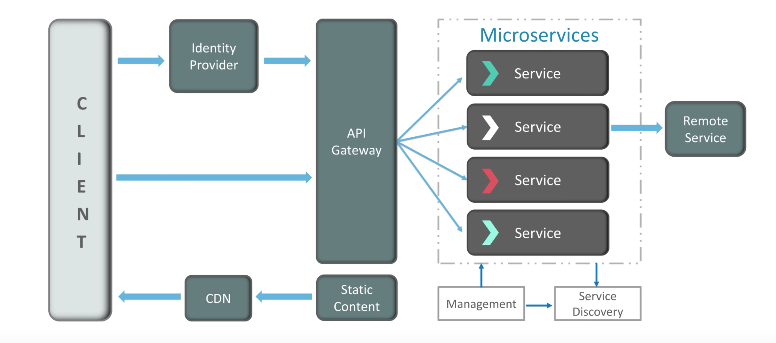
MicroService Architecture

Slide 8
MicroService Architecture

Slide 9
Monolithic vs Microservice

Slide 10
Microservice Features
Decoupling : Easily built, altered and scaled
Autonomy : Teams work Independently
Agility : Features are quick developed
Scalable : Can create many replica of microservices.
De-centralized Governance : No standard patterns.
Continuous Delivery : Allows frequent releases.
Responsibility : Applications are now treated as products.
Componentization : Components can be easily replaced.

Slide 11
Virtualization

Slide 12
Types of hypervisors

Slide 13
Virtualization vs containerization

Slide 14
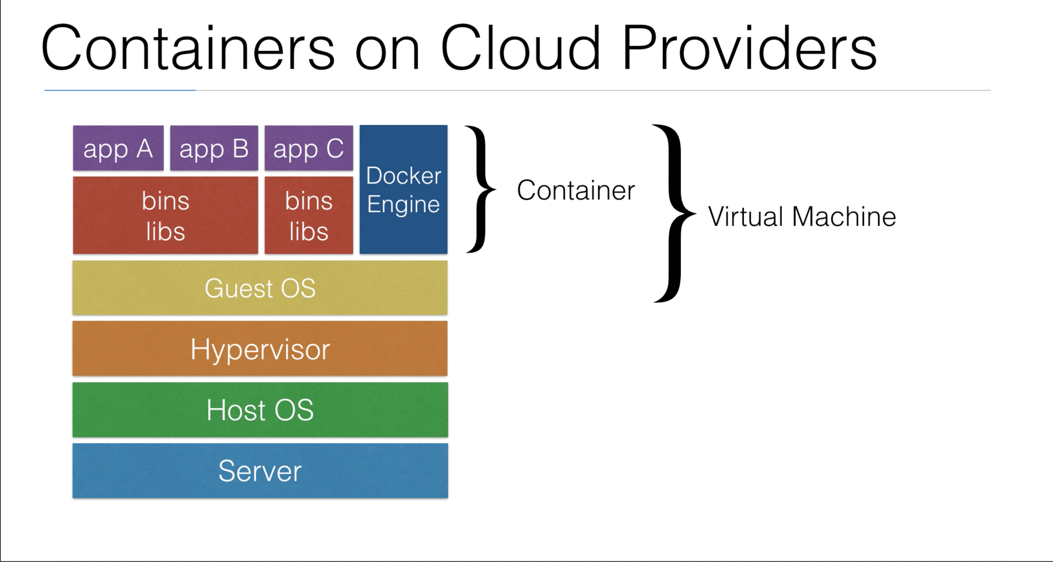
Containerization on CLOUD

Slide 15
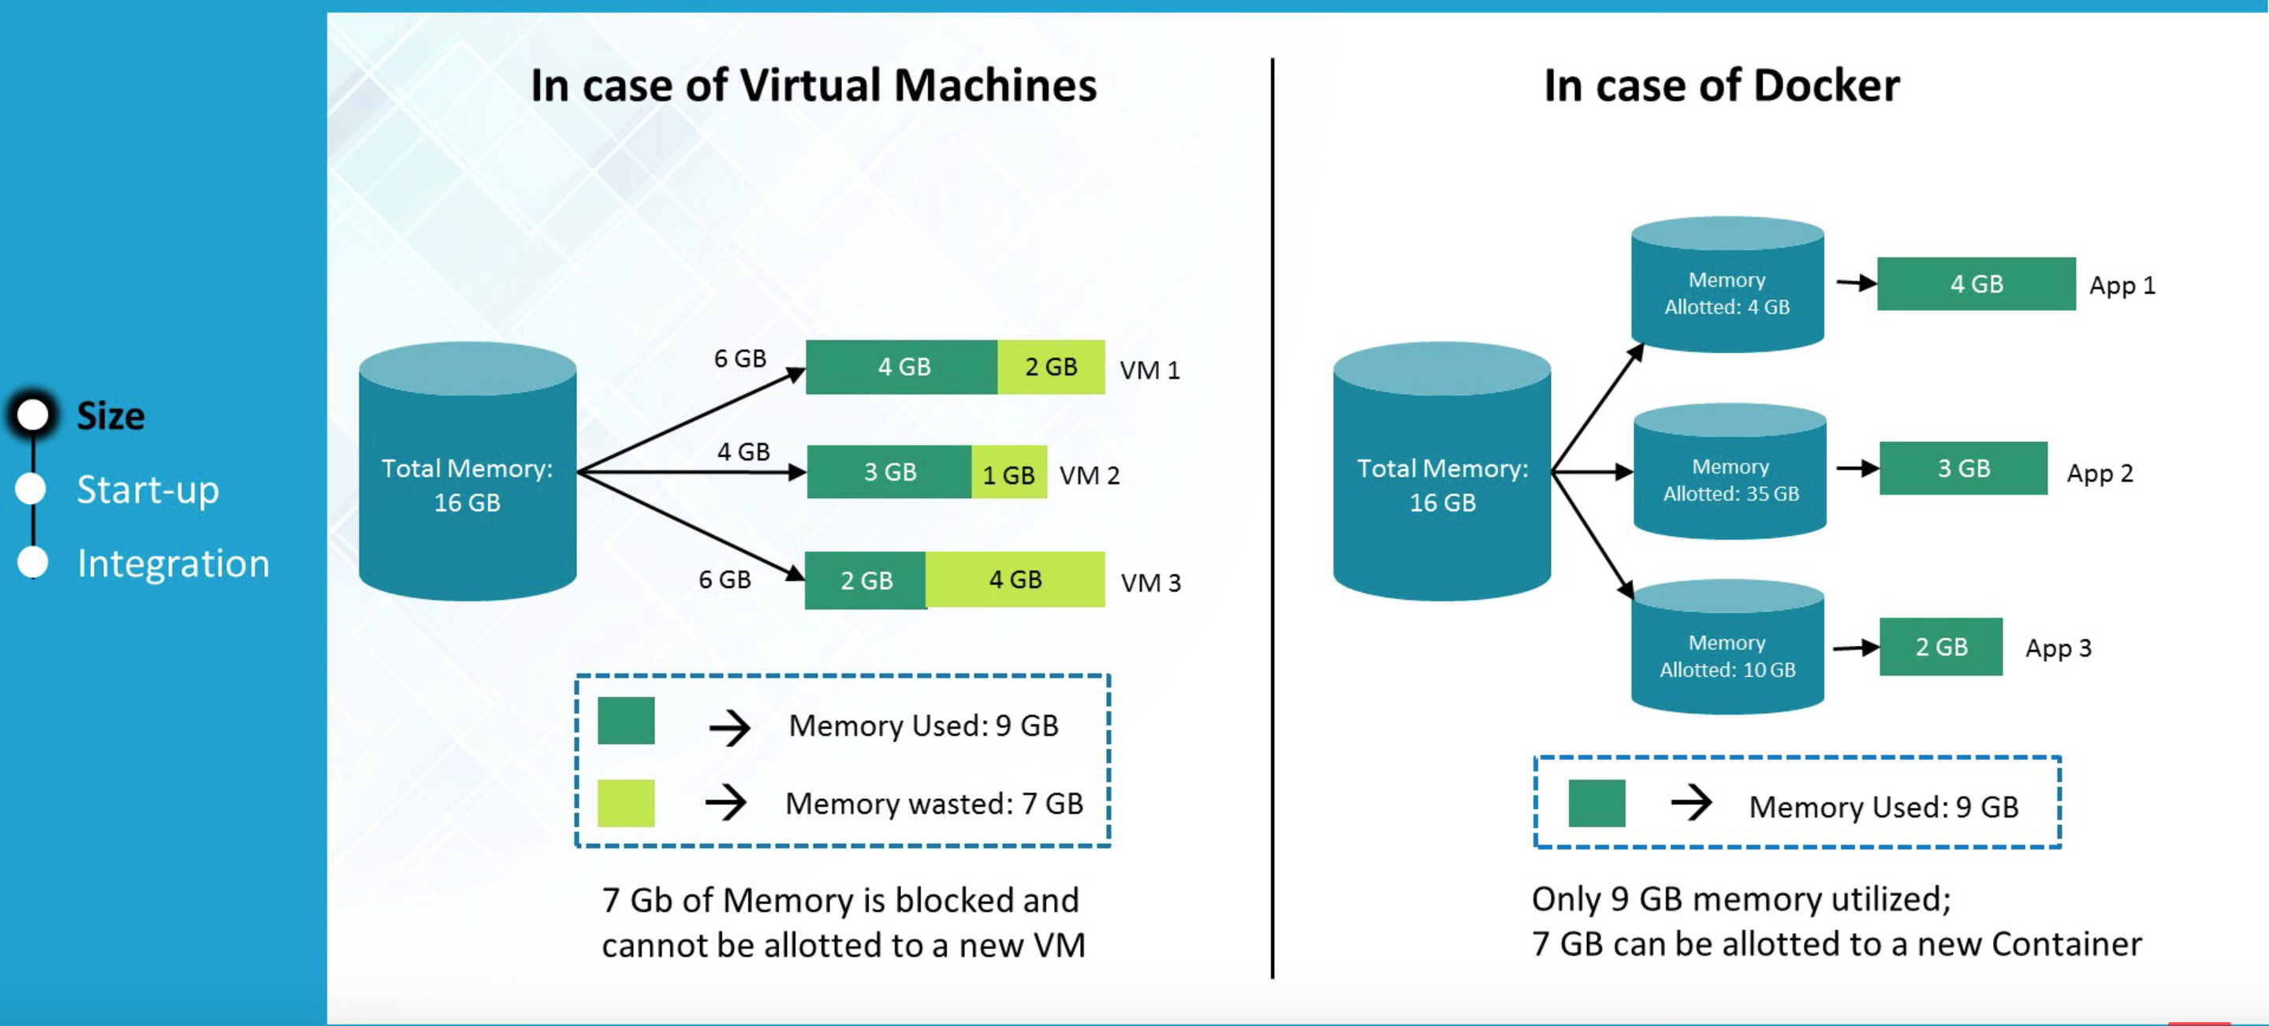
Resource/memory utilization

Slide 16
Known Containerization tools in DEvops
Docker : Open Source
Rkt : Developed by CoreOS
Solaris containers
Microsoft containers

Slide 17
CLUSTER Management & Deployment
Kubernetes : Google’s open source product
Apache Mesos : It can run both docker and RKT images
Docker Swarm : bundled with Docker and free for cluster management

Slide 18
DOCKER

Slide 19
DOCKER
Docker is an open source software platform to create, deploy and manage virtualized application containers on a common operating system (OS), with an ecosystem of allied tools.
Docker is a containerization platform which packages your application and all its dependencies together in the form of containers so as to ensure your application works seamlessly in any environment be it dev or test or prod
Docker Inc., the company that originally developed Docker, supports a commercial edition and is the principal sponsor of the open source tool.

Slide 20
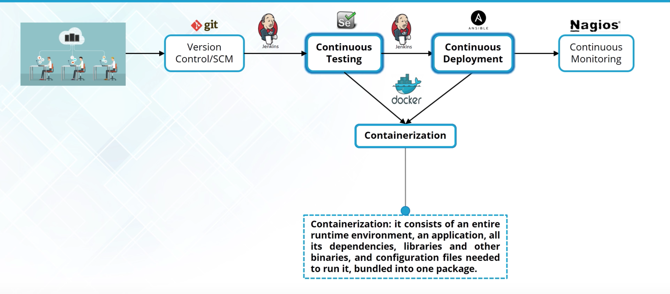
Docker in DEVOPS

Slide 21
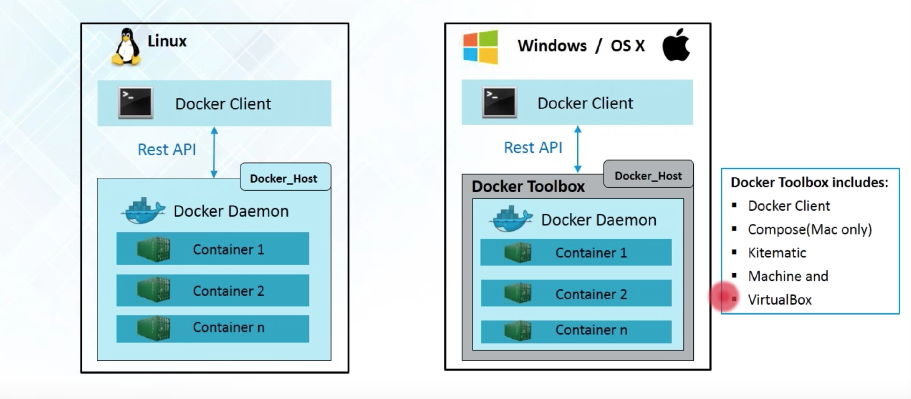
Docker-Architecture

Slide 22
Docker Editions
Learn about the various (dozen+) Editions of Docker
Learn which to use for this course
Learn Docker CE vs. EE
Learn Stable vs. Edge releases

Slide 23
Docker Editions at store.docker.com
Docker is no longer just a "container runtime"
Docker moves fast, it matters how you install it
Docker CE (Community Edition)
Three major types of installs: Direct, Mac/Win, Cloud
Linux (different per distro) (don’t use default package)
Docker for Windows (or legacy Docker Toolbox)
Docker for Mac (or legacy Docker Toolbox) (don’t use brew)
Docker for AWS/Azure/Google

Slide 24
CE vs. EE, Stable vs. Edge
Docker CE (free) vs. Docker EE (paid)
EE = Enterprise Edition
EE = Support + extra products
EE = Certified on specific platforms
docker.com/pricing
Edge (beta) released monthly, Stable quarterly
Edge gets new features first, but only supported for a month
Stable rolls in three months of Edge features, EE supported longer

Slide 25
Continued…

Slide 26
DOCKER Installations

Slide 27
Installation on windows Server 2016
Windows Server 2016 supports native Windows Containers
”Docker for Windows” runs on Win 2016 but not required
Only do this for when you run Win 2016 locally for dev/test. NOT for prod
No options for previous Windows Server versions
Hyper-V can still run Linux VM's (that can run Docker) just fine.
Follow Documentation for Installation steps(Given in resources)

Slide 28
Installation on windows 10(PRO/ENT)
Use Docker for Windows, from store.docker.com
More features then just a Linux VM
Uses Hyper-V with tiny Linux VM for Linux Containers
PowerShell native

Slide 29
Installation on windows 7/8 and 10 Home
Use Docker Toolbox, not as fancy as Docker for Windows
Like others, download at store.docker.com
Runs a tiny Linux VM in VirtualBox via docker-machine
Uses a bash shell to make it more like Linux/Mac options
Does not support Windows Containers

Slide 30
Installation on MAC
Docker for Mac:
Requires Yosemite 10.10.3 (2014 release)
Yosemite works with 2007-2008 Mac's and newer
Docker Toolbox:
For Snow Leopard, Lion, Mountain Lion (10.6-10.8)
Docker in a Linux VM:
Docker in a Windows VM:
Not usually possible, only works with Vmware Fusion

Slide 31
Installation on Linux
Easiest install/setup, best native experience
Three main ways to install: script, store, or docker-machine
get.docker.com script (latest Edge release)
curl -sSL https://get.docker.com/ | sh
store.docker.com has instructions for each distro
RHEL officially only supports Docker EE (paid), but CentOS will work
Installing in a VM, Cloud Instance, all are the same process
May not work for unlisted distros (Amazon Linux, Linode Linux, etc.)
Don't use pre-installed setups (Digital Ocean, Linode, etc.)

Slide 32
DOCKER Containers-Lab

Slide 33
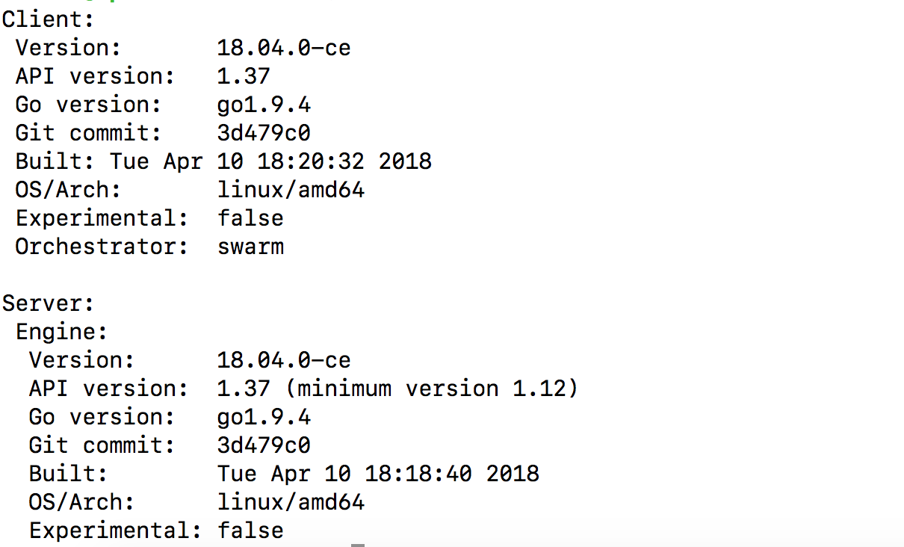
Docker-Commands
docker version : Displays the version of docker client and server daemon

Slide 34
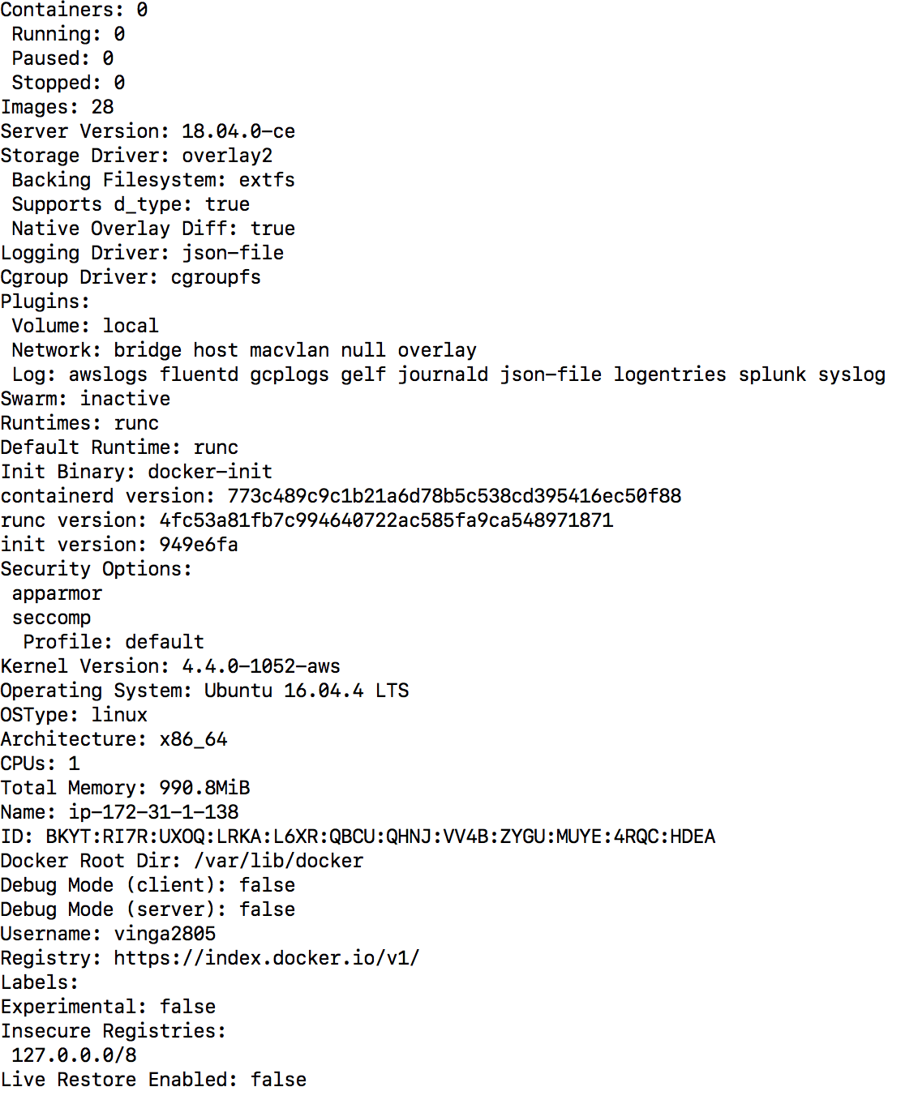
Docker-Commands
docker info: Displays the docker end to end information

Slide 35
Image VS container
An Image is the application we want to run
A Container is an instance of that image running as a process
You can have many containers running off the same image
In this LAB image will be the Nginx web server
Docker's default image "registry" is called Docker Hub (hub.docker.com)

Slide 36
Apache container
docker container run --publish 80:80 httpd
Downloaded image ‘httpd’ from Docker Hub
Started a new container from that image
Opened port 80 on the host IP
Routes that traffic to the container IP, port 80

Slide 37
What happens in 'docker container run'
Looks for that image locally in image cache, doesn't find anything
Then looks in remote image repository (defaults to Docker Hub)
Downloads the latest version (nginx:latest by default)
Creates new container based on that image and prepares to start
Gives it a virtual IP on a private network inside docker engine
Opens up port 80 on host and forwards to port 80 in container
Starts container by using the CMD in the image Dockerfile

Slide 38
Example Of Changing The Defaults
docker container run --publish 8080:80 --name webhost --detach nginx:1.11 nginx –T
OR
docker container run -p 8080:80 --name webhost -d nginx:1.11 nginx -T

Slide 39
Mongo/MYSQL container
docker container run –name mongoDB –d mongo
docker top mongo (To see the process running inside mongo container)
Same process can be seen from host as well by below command
ps aux | grep mongo
docker container run --name mysqlDB --env MYSQL_RANDOM_ROOT_PASSWORD=yes

Slide 40
Assignment-1
Run a nginx, a mysql, and a httpd (apache) server
Run all of them --detached (or -d), name them with --name
nginx should listen on 80:80, httpd on 8080:80, mysql on 3306:3306
When running mysql, use the --environment option (or -e) to pass in MYSQL_RANDOM_ROOT_PASSWORD=yes
Use docker container logs on mysql to find the random password it created on startup
Clean it all up with docker container stop and docker container rm (both can accept multiple names or ID's) •
Use docker container ls to ensure everything is correct before and after cleanup

Slide 41
Whats happening in container
docker container top - process list in one container
docker container inspect - details of one container config
docker container stats - performance stats for all containers

Slide 42
Getting a shell inside container
docker container run -it - start new container interactively.
Ex. docker container run –it --name ubuntu ubuntu
docker container start -ai – start stopped container interactively
Ex. docker container start -ai ubuntu
docker container exec -it - run additional command in existing container
Different Linux distros in containers
We can run only those commands which are already in the image.
Ex docker container run –it alpine bash-→Observe?

Slide 43
Docker Network
Review of docker container run –p
Quick port check with docker container port
Each container connected to a private virtual network "bridge"
Each virtual network routes through NAT firewall on host IP
All containers on a virtual network can talk to each other without -p
Best practice is to create a new virtual network for each app:
network "my_web_app" for mysql and php/apache containers
network "my_api" for mongo and nodejs containers

Slide 44
Docker Network-cli
Show networks docker network ls
Inspect a network docker network inspect
Create a network docker network create --driver
Attach a network to container docker network connect
Detach network container docker network disconnect

Slide 45
Docker Network - DNS
Containers shouldn't rely on IP's for inter-communication
DNS for friendly names is built-in if you use custom networks
You're using custom networks right? •This gets way easier with Docker Compose in future Section

Slide 46
Assignment-2
Use different Linux distro containers to check curl cli tool version
Use two different terminal windows to start bash in both centos:7 and ubuntu:14.04, using -it
Learn the docker container --rm option so you can save cleanup
Ensure curl is installed and on latest version for that distro
ubuntu: apt-get update && apt-get install curl
centos: yum update curl
Check curl --version

Slide 47
Assignment-3
Ever since Docker Engine 1.11, we can have multiple containers on a created network respond to the same DNS address
Create a new virtual network (default bridge driver)
Create two containers from elasticsearch:2 image
Research and use --net-alias search when creating them to give them an additional DNS name to respond to
Run alpine nslookup search with --net to see the two containers list for the same DNS name
Run centos curl -s search:9200 with --net multiple times until you see both "name" fields show

Slide 48
Docker Images
App binaries and dependencies
Metadata about the image data and how to run the image
Official definition: "An Image is an ordered collection of root filesystem changes and the corresponding execution parameters for use within a container runtime."
Not a complete OS. No kernel, kernel modules (e.g. drivers)
Small as one file (your app binary) like a golang static binary
Big as a Ubuntu distro with apt, and Apache, PHP, and more installed

Slide 49
Docker-HUB
Basics of Docker Hub (hub.docker.com)
Find Official and other good public images
Download images and basics of image tags
Using different base images like Debian or Alpine
The recommended tagging scheme used by Official images

Slide 50
Image and their layers
Images are made up of file system changes and metadata
Each layer is uniquely identified and only stored once on a host
docker history image_name
docker inspect image_name
This saves storage space on host and transfer time on push/pull
A container is just a single read/write layer on top of image
docker image history and inspect commands can teach us

Slide 51
Tags
All about image tags
Properly tagging images
docker image tag source_tag target_tag
Tagging images for upload to Docker Hub
How tagging is related to image ID
How to upload to Docker Hub
Image ID vs. Tag

Slide 52
Building custom images
We can not use existing images all the time, as this may not suit to your application.
Custom images can be created from Dockerfile.
Dockerfile basics:
FROM (base image) •
ENV (environment variable)
RUN (any arbitrary shell command)
EXPOSE (open port from container to virtual network)
CMD (command to run when container starts)
docker image build (create image from Dockerfile)

Slide 53
Assignment-4
Use the Alpine version of the official 'node' 6.x image
Check Assignment 4 in resources section
Expected result is web site at http://localhost
Tag and push to your Docker Hub account (free)
Remove your image from local cache, run again from Hub

Slide 54
Containers Lifetime and Persistent Data
Containers are usually immutable and ephemeral
"immutable infrastructure": only re-deploy containers, never change
This is the ideal scenario, but what about databases, or unique data?
Docker gives us features to ensure these "separation of concerns"
This is known as "persistent data"
Two ways: Volumes and Bind Mounts
Volumes: make special location outside of container UFS
Bind Mounts: link container path to host path

Slide 55
Persistent Data: volumes
VOLUME command in Dockerfile
Also override with docker run -v /path/in/container
Bypasses Union File System and stores in alt location on host
By default they only have a unique ID, but you can assign name
Then it's a "named volume"

Slide 56
Persistent Data: Bind Mounting
Maps a host file or directory to a container file or directory
Basically just two locations pointing to the same file(s)
Again, skips UFS, and host files overwrite any in container

Slide 57
Docker-composE
Compose is a tool for defining and running multi-container Docker applications.
With Compose, you use a YAML file to configure your application’s services.
Then, with a single command, you create and start all the services from your configuration.
To learn more about all the features of Compose
Features :
The features of Compose that make it effective are:
Multiple isolated environments on a single host
Preserve volume data when containers are created
Only recreate containers that have changed
Variables and moving a composition between environments

Slide 58
Docker-compose cli
CLI Tool comes with Docker for Windows/Mac, but need to download it seperately for Linux.
Ideal for local development.
Two major commands.
docker-compose up
docker-compose down
You can use below commands to setup entire application from GIT
git clone github.com/some/software
docker-compose up

Slide 59
Assignment-5
Build a basic compose file for a Drupal content management system website.(get help from dockerhub)
Use Drupal and postgres image.
Expose 8080 port for drupal container.
Set password for postgres by “ POSTGRES_PASSWORD”
Setup Drupal via browser.

Slide 60
Assigment-6
Build and Run Compose.
Start with compose file from previous assignment5.
Make your own Dockerfile and docker-compose.yml in Assignment6 folder.
Use README.md file for more details

Slide 61
DOCKER SWARM

Slide 62
Containers Everywhere
How do we automate container lifecycle?
How can we easily scale out/in/up/down?
How can we ensure our containers are re-created if they fail?
How can we replace container without downtime?(B-G Deployment)
How can we control/track where containers gets created?
How can we store secrets, keys, password and get them in right container?

Slide 63
SWARM-Built in orchestration
A swarm is a group of machines that are running Docker and joined into a cluster.
After that, you continue to run the Docker commands you’re used to, but now they are executed on a cluster by a swarm manager.
The machines in a swarm can be physical or virtual.
After joining a swarm, they are referred to as nodes.
Swarm managers are the only machines in a swarm that can execute your commands, or authorize other machines to join the swarm as workers.
Workers are just there to provide capacity and do not have the authority to tell any other machine what it can and cannot do.
Up until now, you have been using Docker in a single-host mode on your local machine. But Docker also can be switched into swarm mode, and that’s what enables the use of swarms.
Enabling swarm mode instantly makes the current machine a swarm manager. From then on, Docker runs the commands you execute on the swarm you’re managing, rather than just on the current machine.

Slide 64
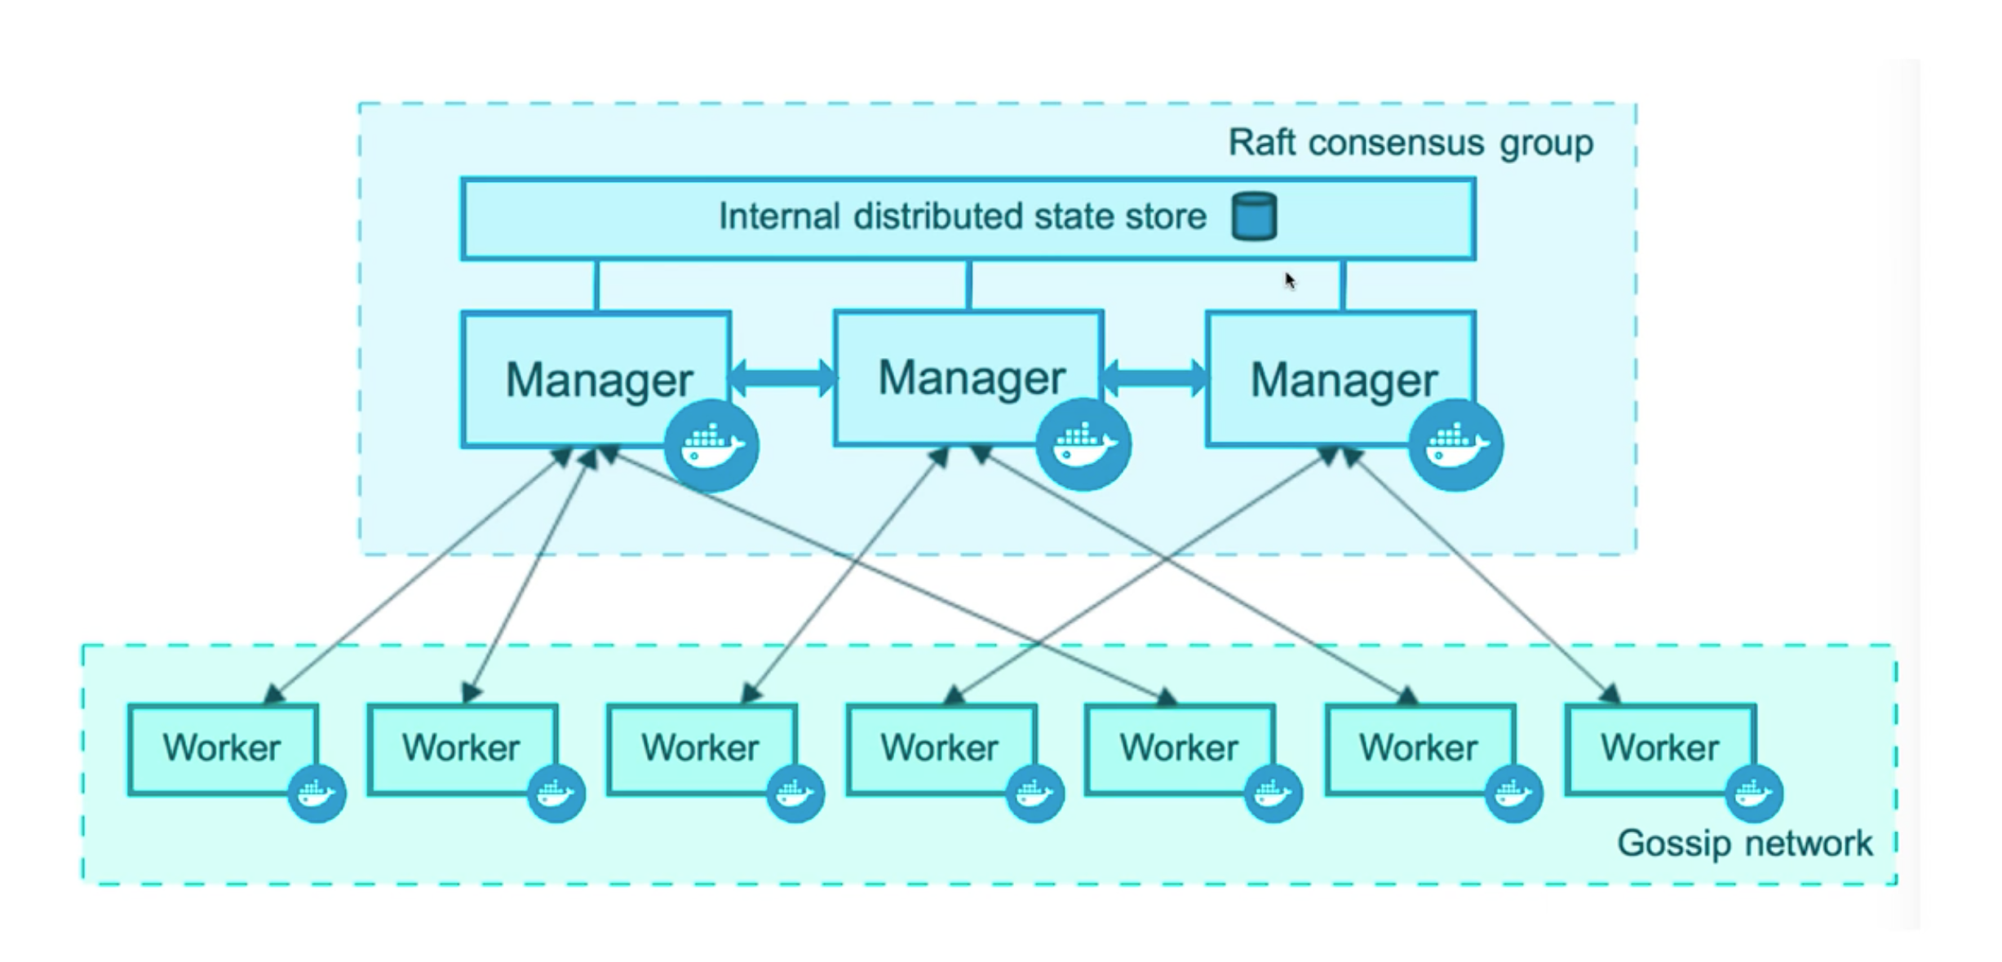
Architecture

Slide 65
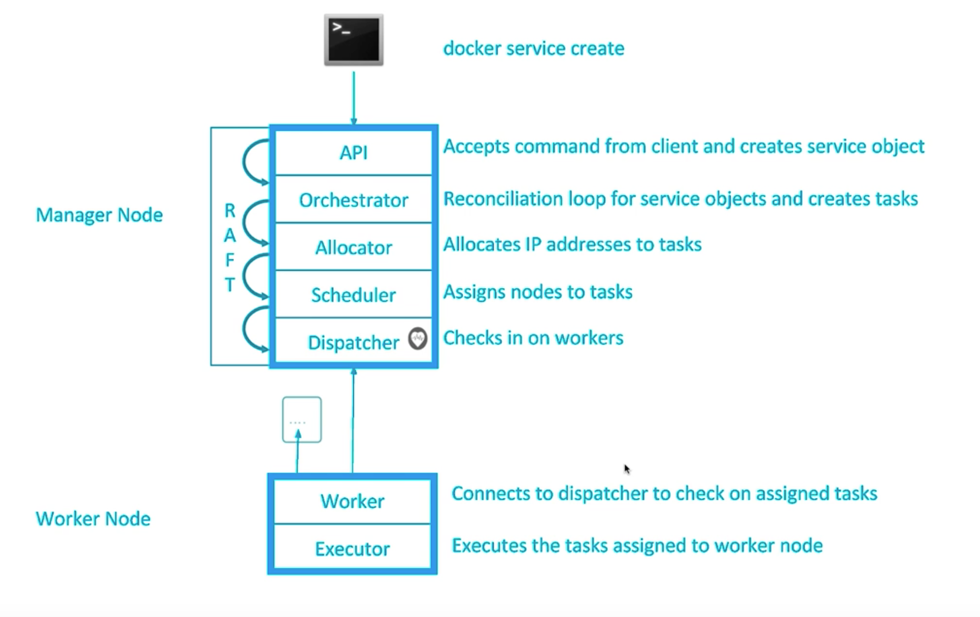
Architecture in Detail

Slide 66
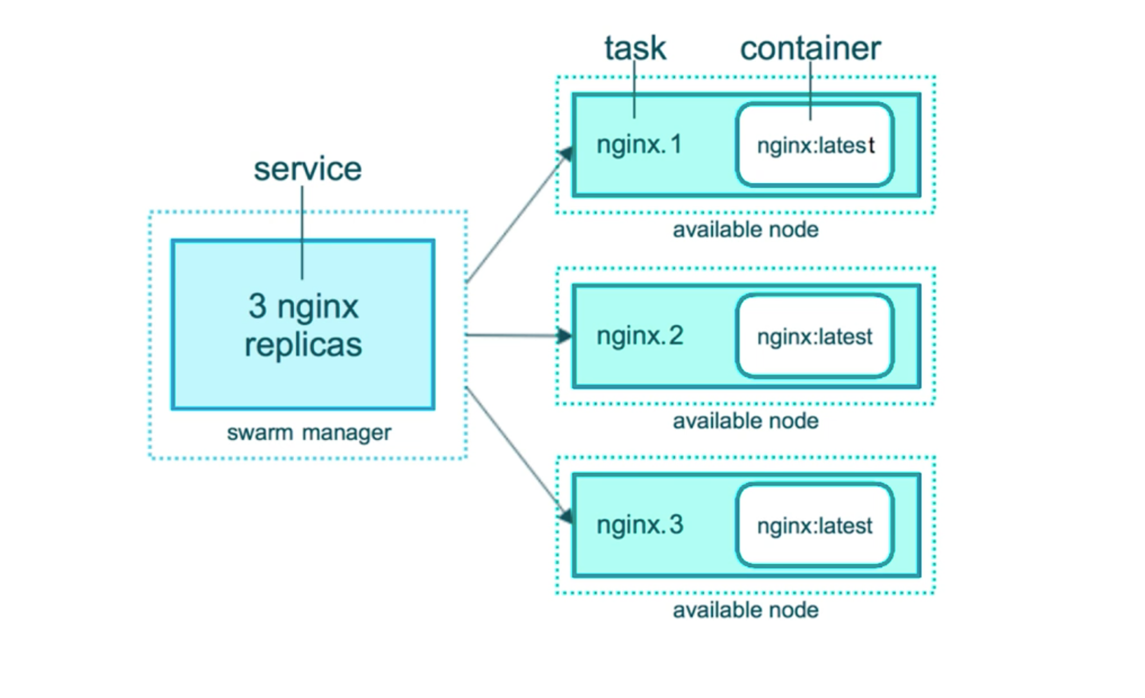
Example: NGINX

Slide 67
Docker swarm init
Whats just happened?
Lots of PKI and security automation
Root signing certificate created for SWARM
Certificate is issued for the first manager node.
Join Tokens are created.
Raft Database created to store root CA, config and secrets.

Slide 68
Docker swarM:3 node cluster
Play-with-docker.com
Only needs browser but reset after 4 hours.
Docker Machine + Virtual Box
Free and can be used locally, Needs at least 8GB RAM
Roll your own machine on AWS/AZURE/GCP
Install docker by get.docker.com

Slide 69
Docker SWARM command
docker swam --help
docker node –help
docker service –help
Examples:
docker service create alpine ping 8.8.8.8
docker service ls
docker service ps <Service_id>
docker node ps

Slide 70
Docker SWARM Networking
Docker swarm uses a separate network driver called overlay
docker network create --driver overlay mynet
Overlay network is only for container to container traffic inside a single swarm.
Each service can connect to one or more network.(Frontend and backend)
We can see by drupal example

Slide 71
Routing mesh
Routes ingress packets for a service to proper task.
Spans all the nodes in a cluster
Load balances Swarm services across their tasks.
Two way it works.
Container to container in a overlay network (use VIP).(E.g. Elasticsearch:2)
External traffic incoming to published ports (all node listen)(E.g. Drupal)

Slide 72
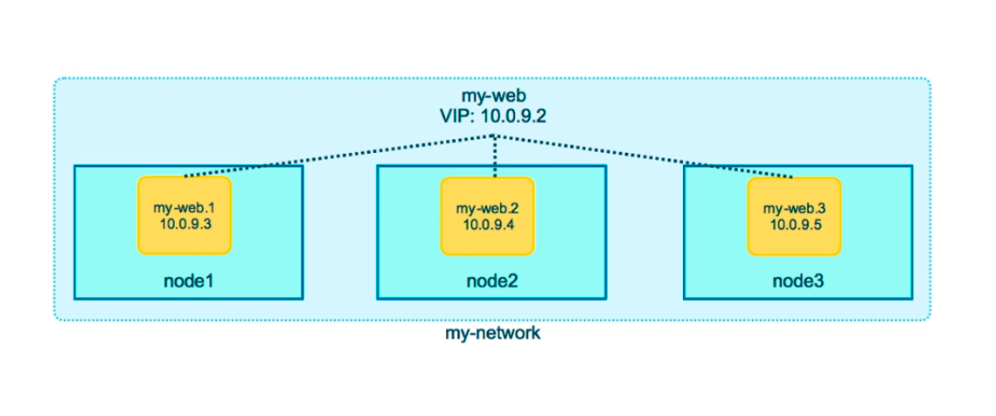
Overlay

Slide 73
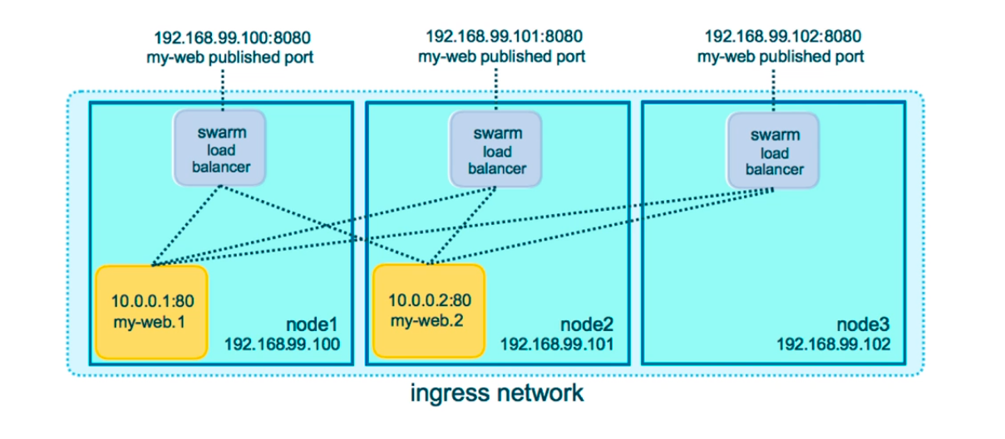
Ingress Network traffic

Slide 74
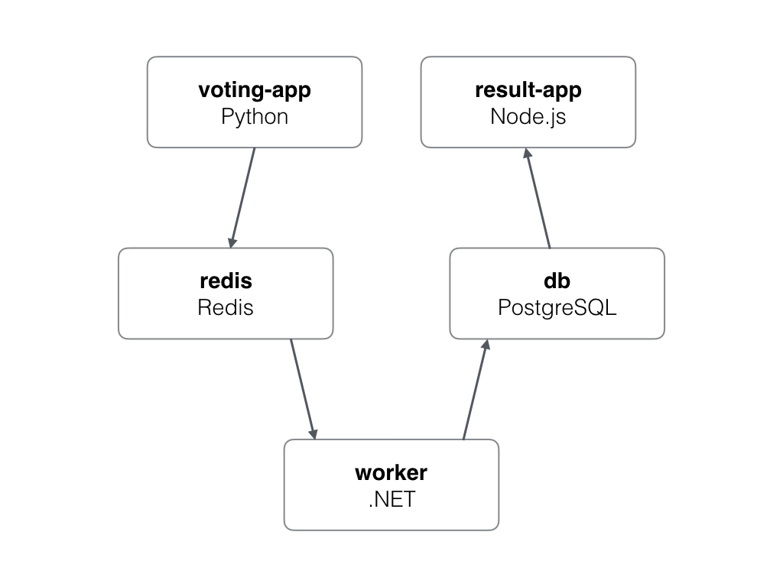
Docker swarm app

Slide 75
Docker Swarm Stack
In 1.13 Docker adds a new layer of abstraction to swarm called Stacks.
Production grade compose.
Stack accept compose files as their declarative definition for services, network and volumes.
We use docker stack deploy rather than docker service create.
Stack manages all for us, including overlay network per stack.
New deploy: key in compose file. Can not do build because docker stack is for production build.
docker-compose is now not needed on swarm cluster.

Slide 76
Docker secrets
Easiest “secure” solution for storing secrets in swarm.
What is a secret?
Username and password.
SSH keys
TLS certificate and keys
Secrets are first stored in Swarm then assign to a service
Only containers is assigned service can see them
docker secret create username user.txt
echo "mypass" | docker create secret dbpass -
docker service create --name psql --secret username --secret dbpass -e POSTGRES_USER_FILE=/run/secrets/username -e POSTGRES_PASSWORD_FILE=/run/secrets/dbpass postgres

Slide 77
Kubernetes

Slide 78
What is kubernetes
Kubernetes is based on years of Google’s experience of running workloads at a huge scale in production.
As per Kubernetes website, “Kubernetes is an open-source system for automating deployment, scaling, and management of containerized applications.”
It groups containers that make up an application into logical units for easy management and discovery.

Slide 79
More about kubernetes
It lets you schedule containers on a cluster of machines
You can run multiple containers on a same machine
You can run long running services(Web application)
Kubernetes manages the state of these containers
Can start container on a specific node
Will restart container when it gets failed.
Can move containers from one machine to another.
Kubernetes can start with one node until thousands of nodes

Slide 80
Kubernetes Features:
Automatic Binpacking
Horizontal scaling
Self healing
Automated rollouts and rollbacks
Storage orchestration
Secret and configuration Management.
Batch execution

Slide 81
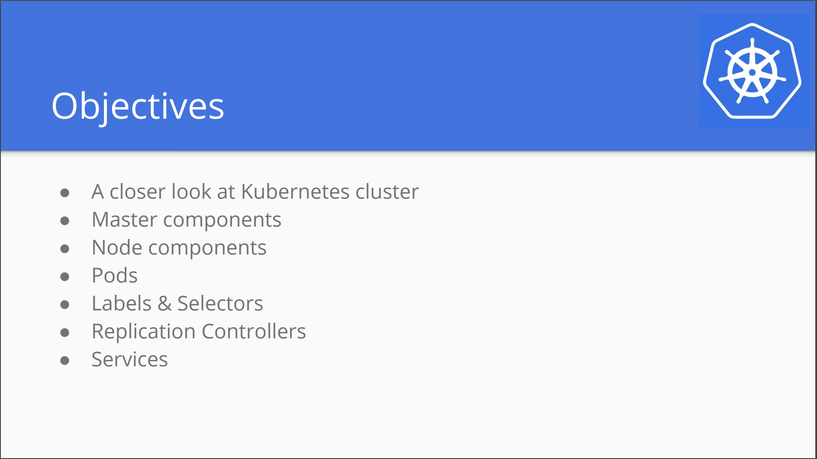

Slide 82
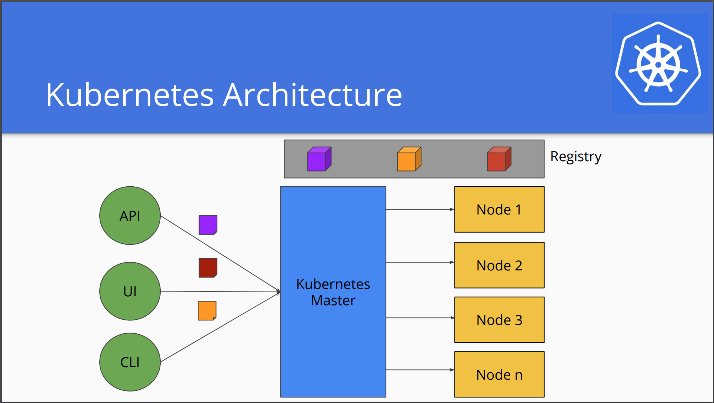

Slide 83
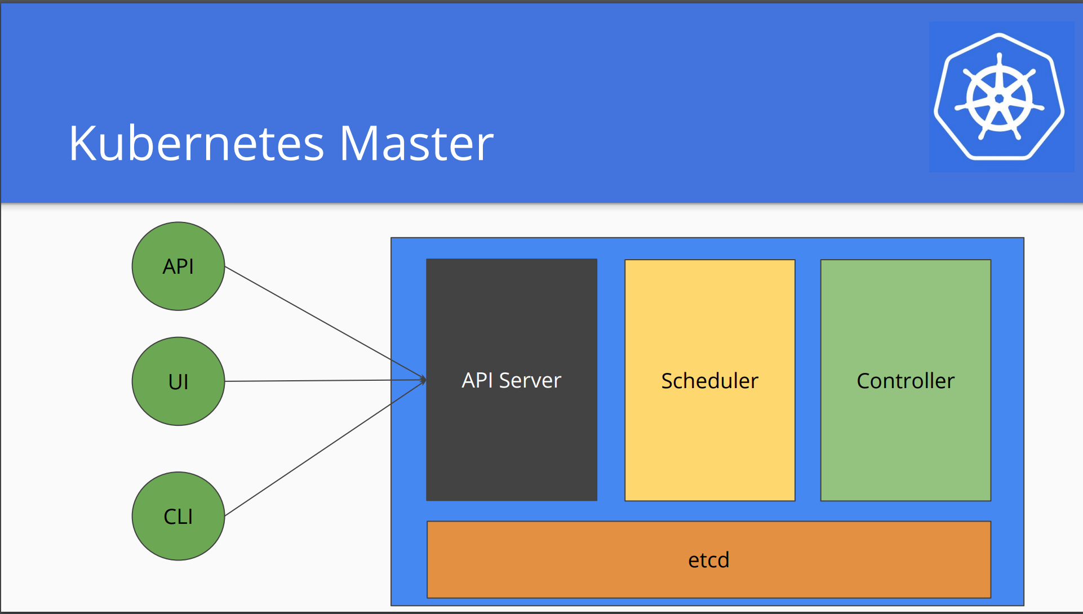

Slide 84
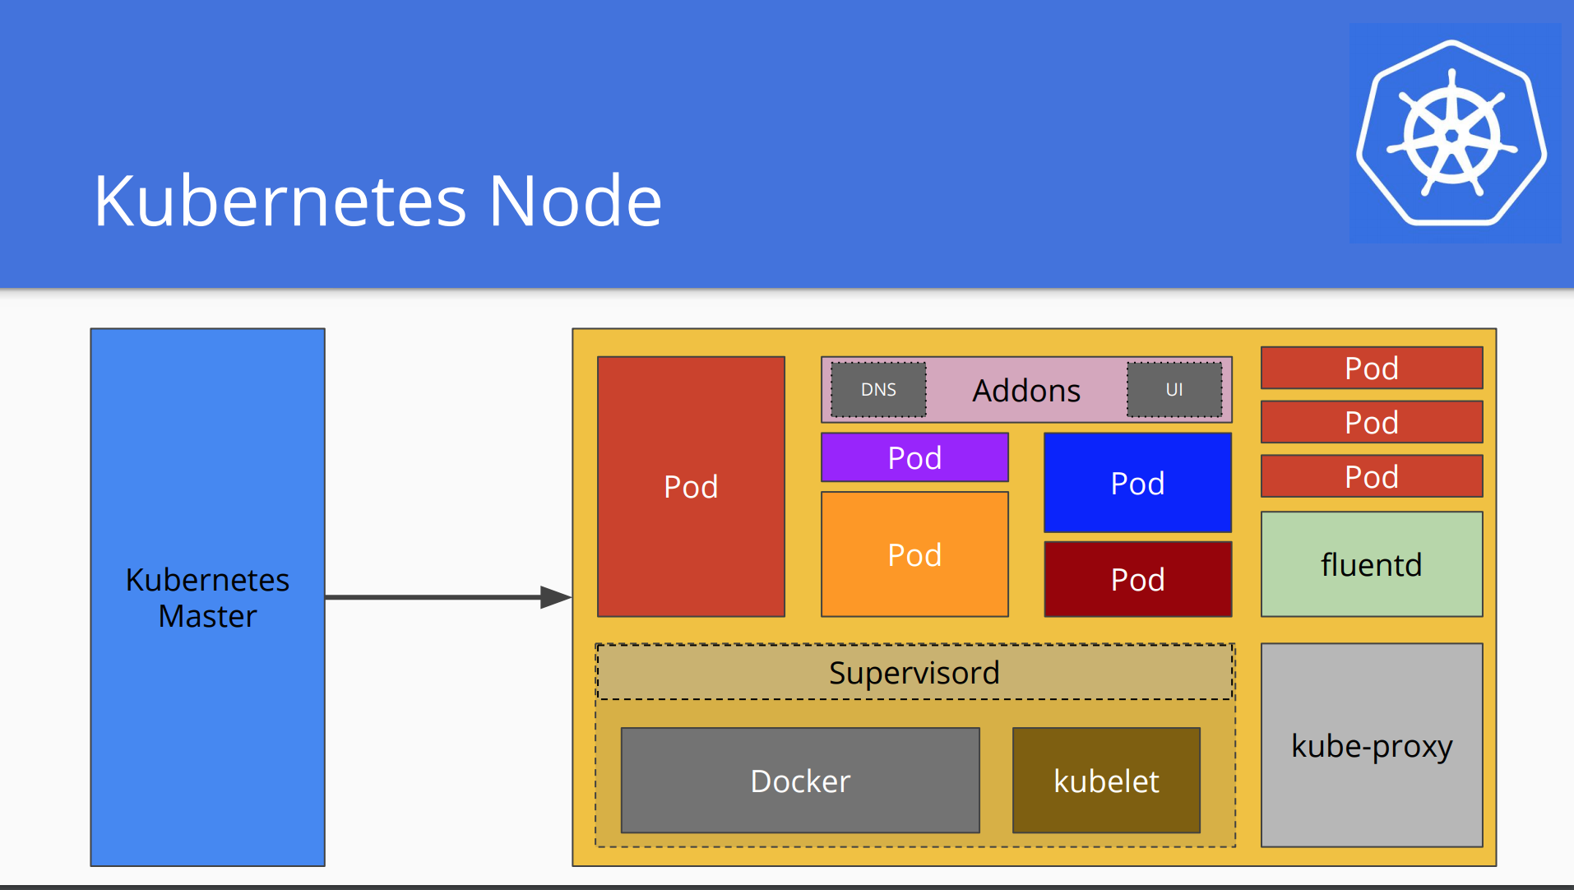

Slide 85
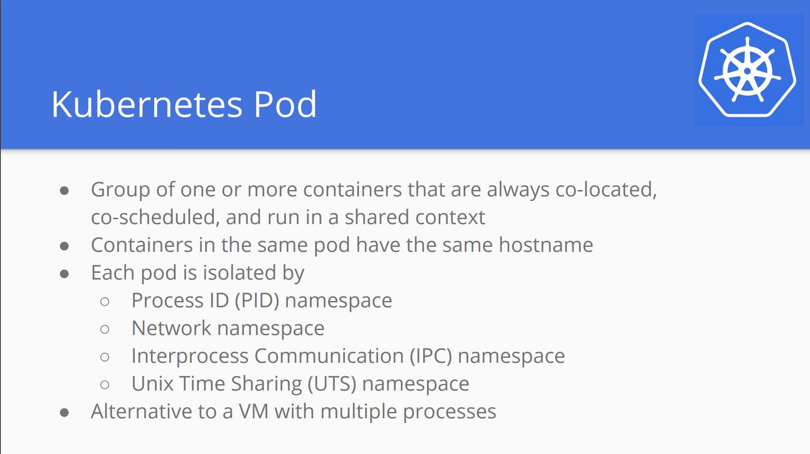

Slide 86
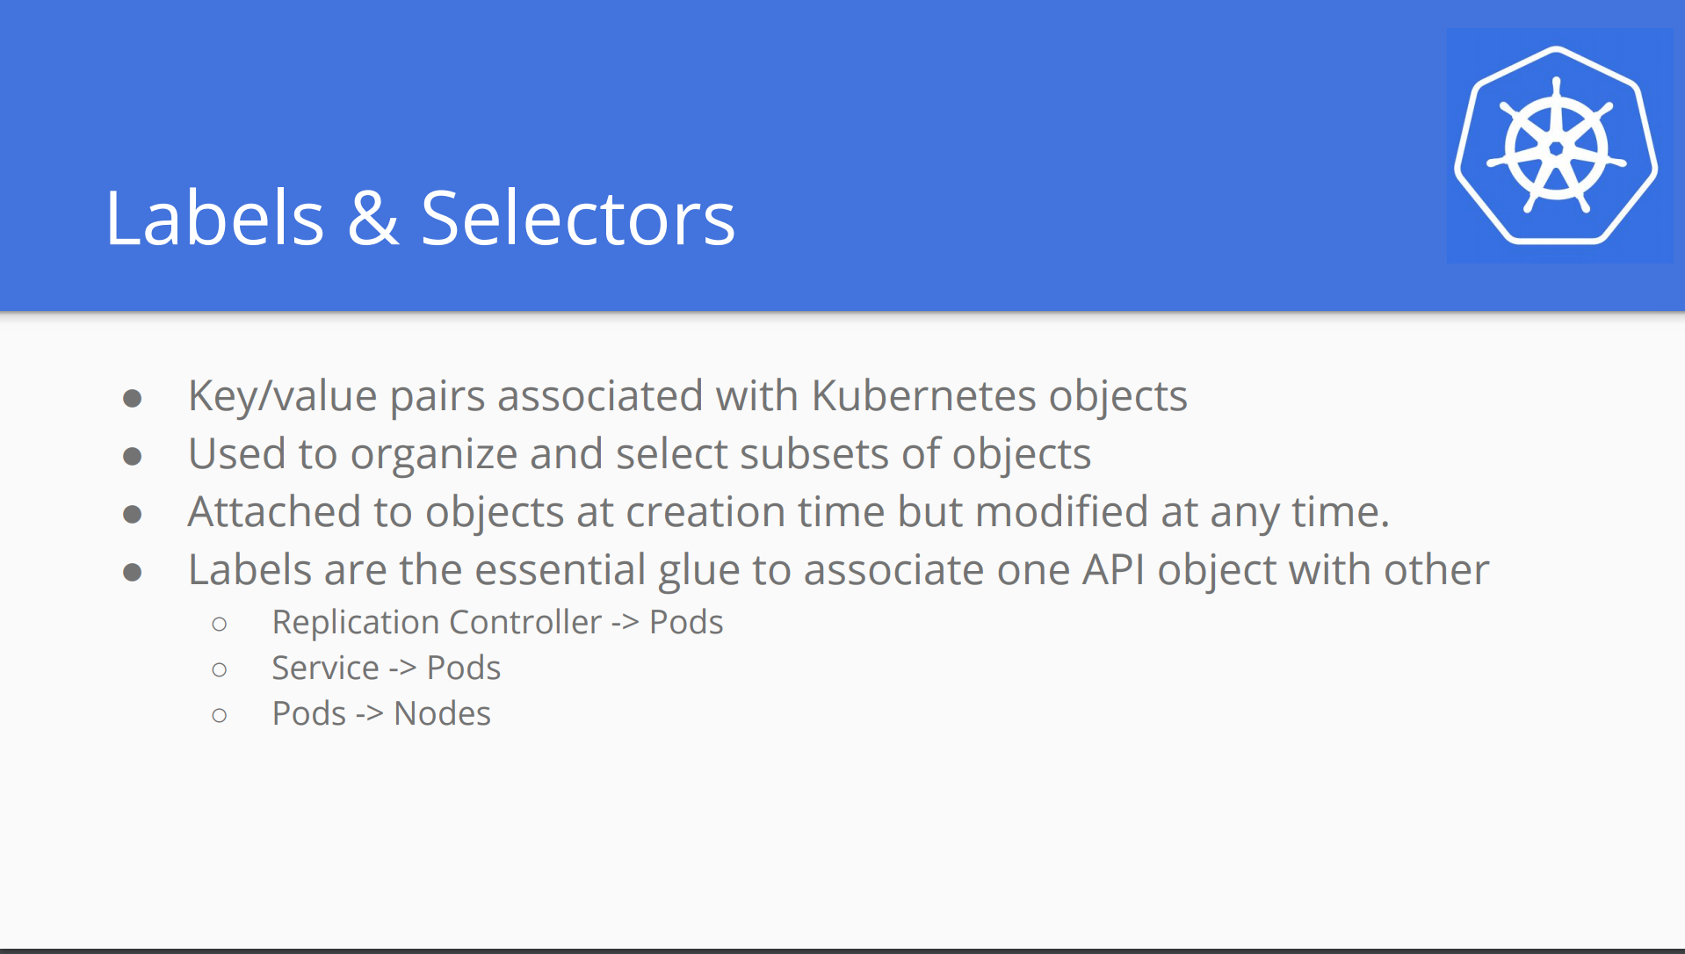

Slide 87
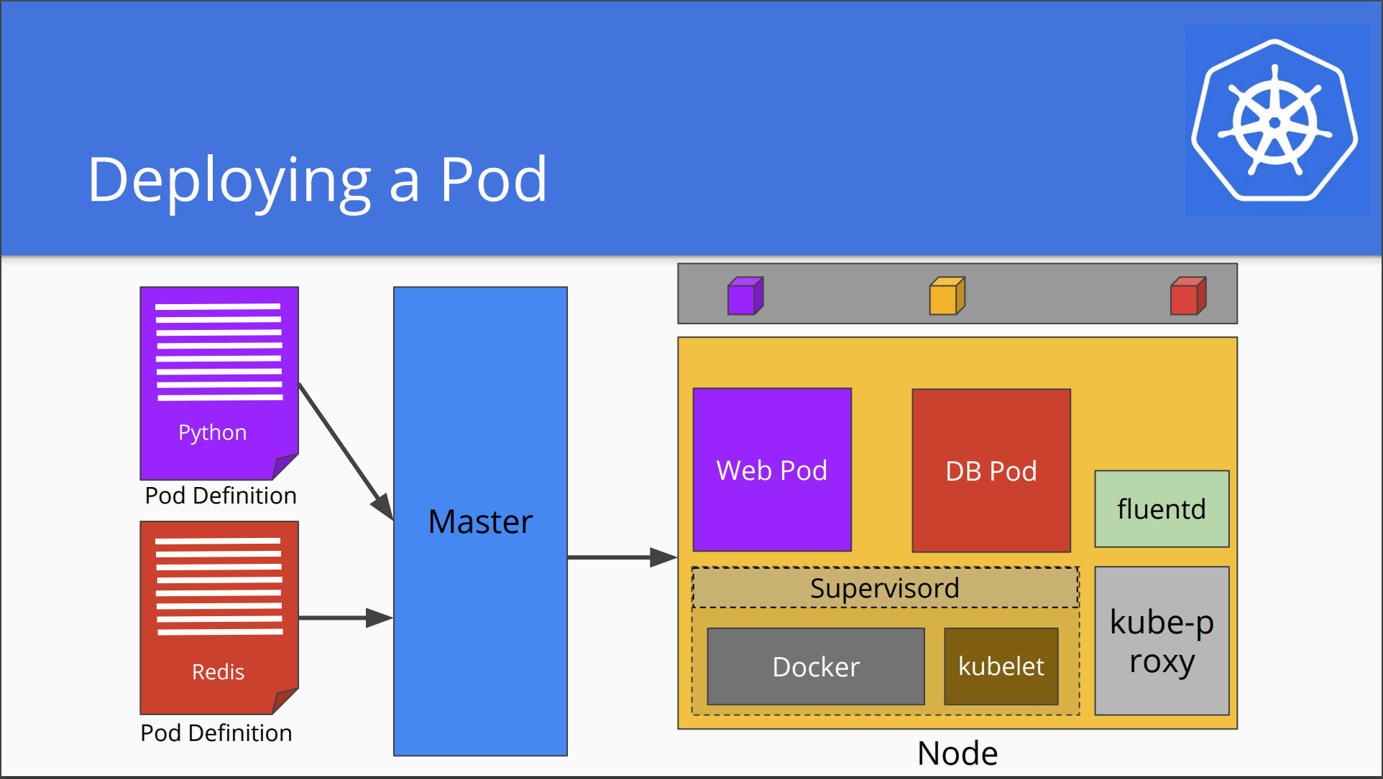

Slide 88
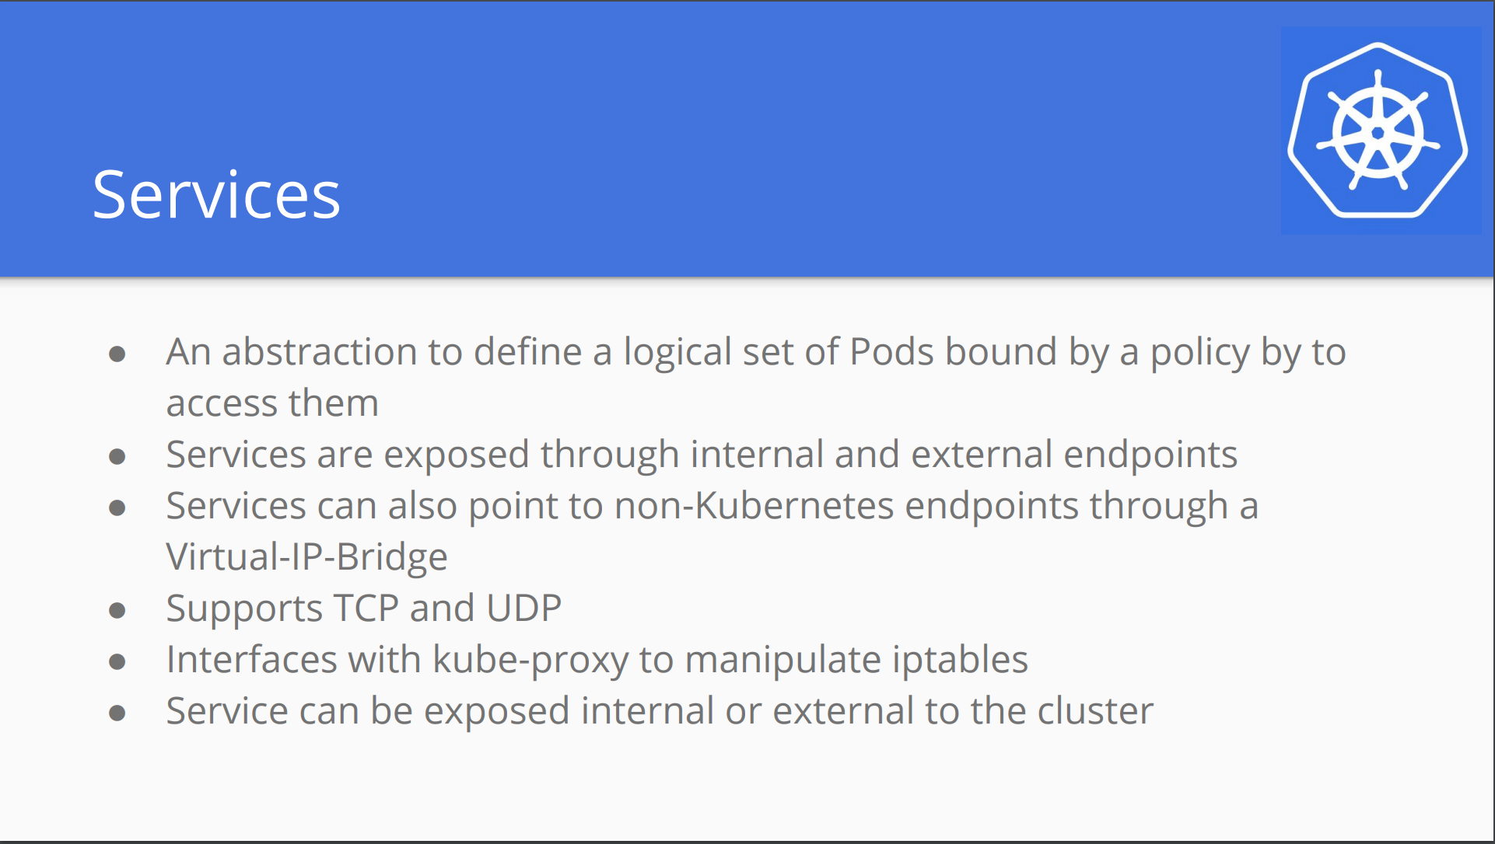

Slide 89
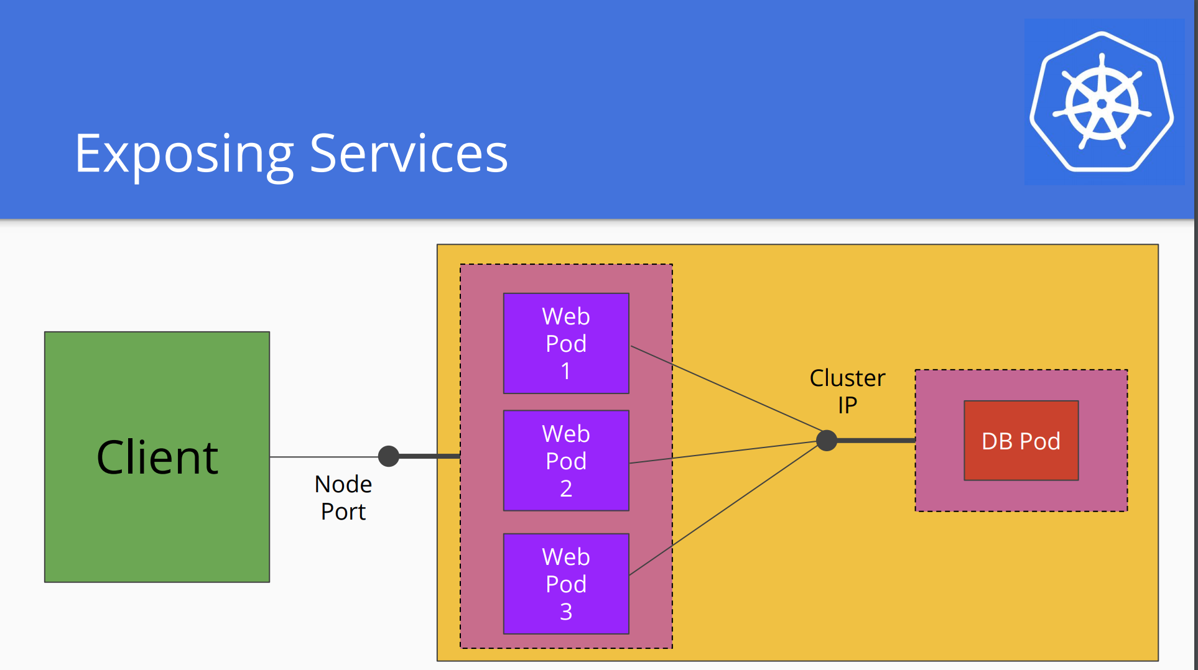

Slide 90
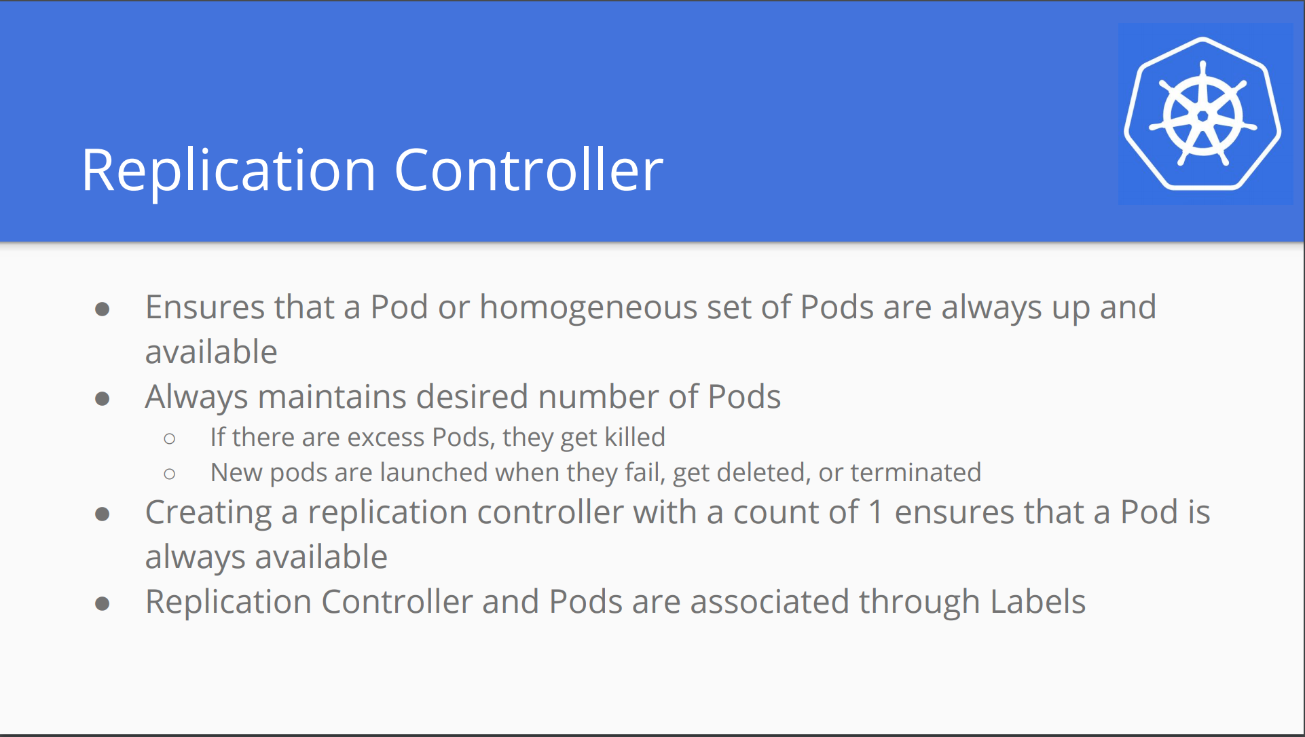

Slide 91
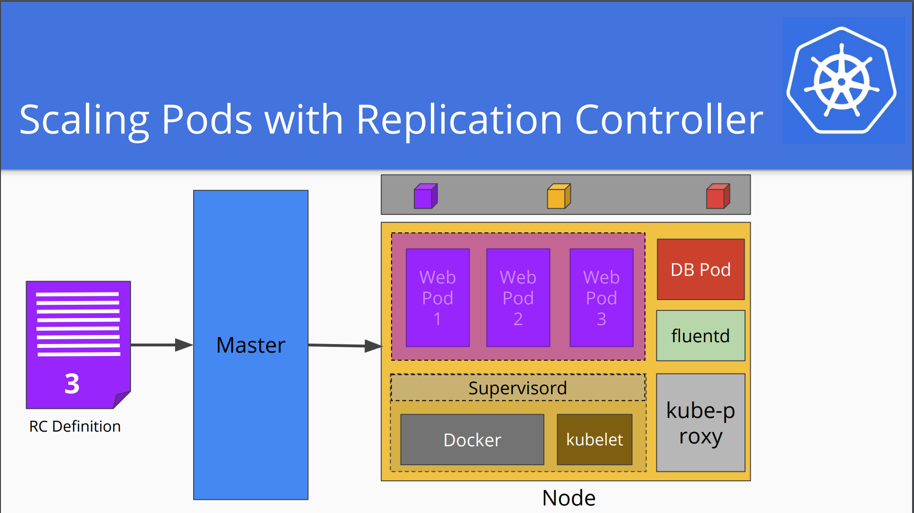

Slide 92
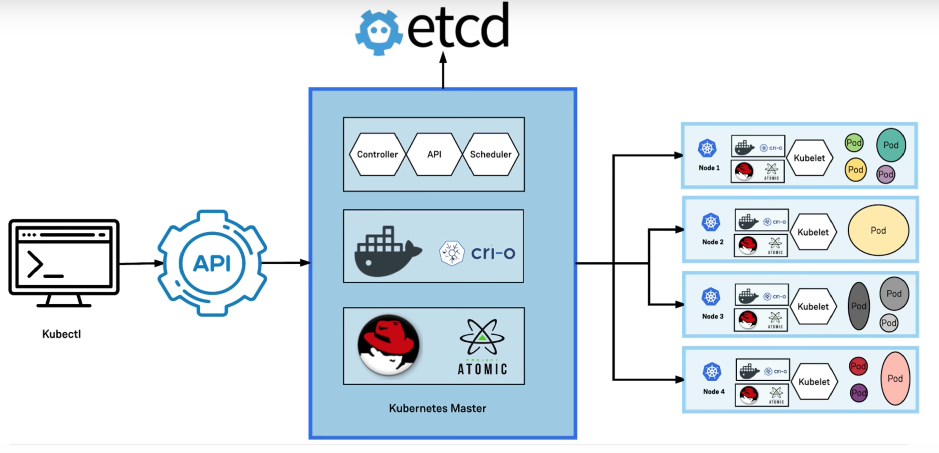

Slide 93
Kubernetes anywhere
You can Kubernetes anywhere
On-premise (Own Datacenter)
Public cloud (Google/AWS/Azure)
Hybrid: Public& Private

Slide 94
Kubernetes Setup
Kubernetes can be run from anywhere
More integrations required for certain cloud providers
Things like Volumes and External Load Balancers works only with supported cloud provider(AWS/AZURE)
Minikube – for quickly single machine Kubernetes cluster
https://github.com/kubernetes/minikube
Kops : creating kubernetes cluster in aws
This can be used to spin up highly available PROD cluster on AWS

Slide 95
Create first app on k8s
kubectl create –f helloworld.yml
kubectl get pods
kubectl describe pod <pod_name>
kubectl port-forward <pod_name> 8080:3000 (Only for local host)
kubectl expose pod <> --type=NodePort --name=hello-service
kubectl get svc
Minikube service <service_name> --url

Slide 96
What happens in backgroud
As soon as Master gets a request to create a pod, It assigns the task to scheduler.
Scheduler on the master checks which node is free and assigns the task to least loaded worker/node.
Kubelet on the node receives the task, mount the necessary volumes.
Then, kubelet pulls the image mentioned in the pod definition and create container accordingly post which it starts.

Slide 97
Some useful commands
Run command in the running container
Kubectl exec <pod_name> -- command
You can install one ubuntu machine to check or ping internal containers.
Kubectl run –it ubuntu --image=centos --restart=Never – sh
Inside you can ping/curl to different pod
You can describe services by below command.
Kubectl describe service <service_name>
Delete pod and services
Kubectl delete pod <pod_name>
Kubectl delete service <service_name>

Slide 98
Load balancer as a service
This creates a ELB in AWS.
This will route the traffic between worker/nodes.
Go to first_app folder
Kubectl create –f helloworld.yml
Kubectl create –f helloworld-service.yml
Check both pod and service.
Check if ELB is created and able to route the traffic.

Slide 99
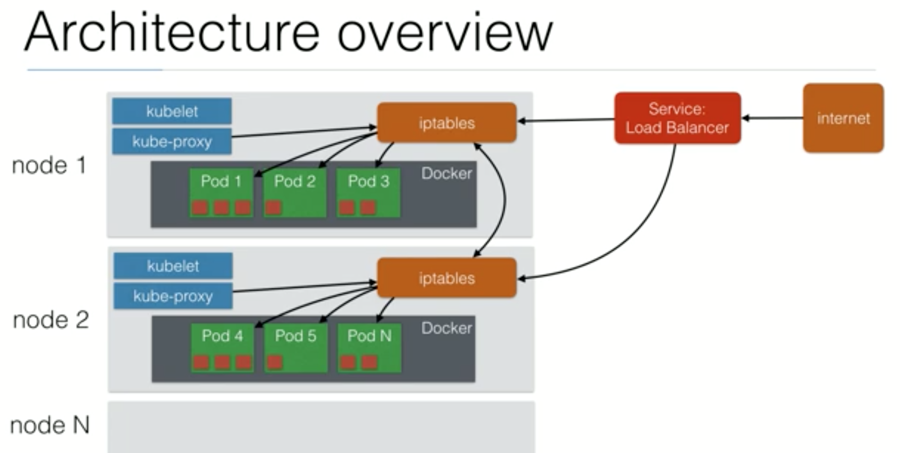
Revisit-Architecture

Slide 100
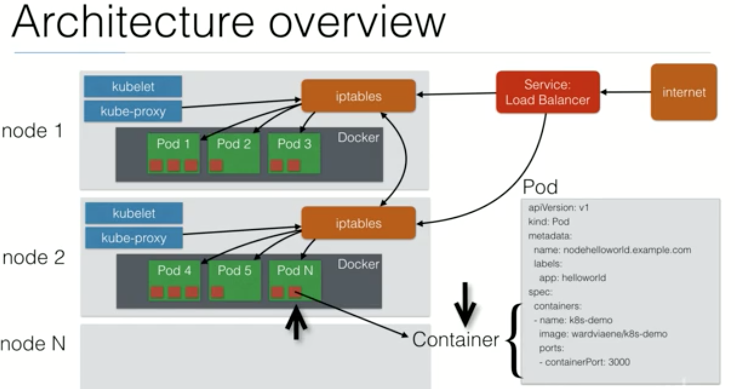

Slide 101
Scaling-PODS
Stateless Applications can be scaled horizontally
Stateless: Your application does not have a state, Its does not write to any local files/session
All Databases are stateful in nature, they have database files that can not be split over multiple instances.
Most web applications can be made stateless.
Session data must be placed outside container.
Any files can not be saved locally in container
Stateful apps can be scaled vertically(Allocate more memory/CPU)

Slide 102
Scaling-Replication Controller
Scaling in Kubernetes can be done using Replication Controller.
RC will ensure a specified number of POD replicas will run all time
A pod created with RC will automatically be replace if they fail,get deleted/terminated.
You can run RC with just 1 replica
This makes sure the pod is always running.

Slide 103
RC-DEMO
Go to replication-controller folder.
Kubectl create -f helloworld-repl-controller.yml
Kubectl get rc
You can scale rc by below command.
Kubectl scale --replicas=4 –f <yml file for replica controller>
OR
Kubectl scale --replicas=1 rc/rc_name

Slide 104
Replication SET
Next Generation Replication Controller.
It suuports new selector that can do selection based on filtering according to set values.
E.g “Environment” either dev or test
Not only based on equality like RC.
E.g “Environment” == “dev”
RS rather than RC used by deployment object

Slide 105
Deployments
This allows you to do app Deployment.
When using Deployment object, you define the state of your application.
Kubernetes will make sure the clusters matches your desired state.
So just RC and RS migtht be cumbersome to deploye apps

Slide 106
Deployment
With Deployment object you can.
Create a new deployment.
Update a deployment
Rolling update
Rollback to previous version.
Pause/Resume deployment.
You can create service for your deployment by below command.
kubectl expose deployment <Deployment_name> --type=NodePort

Slide 107
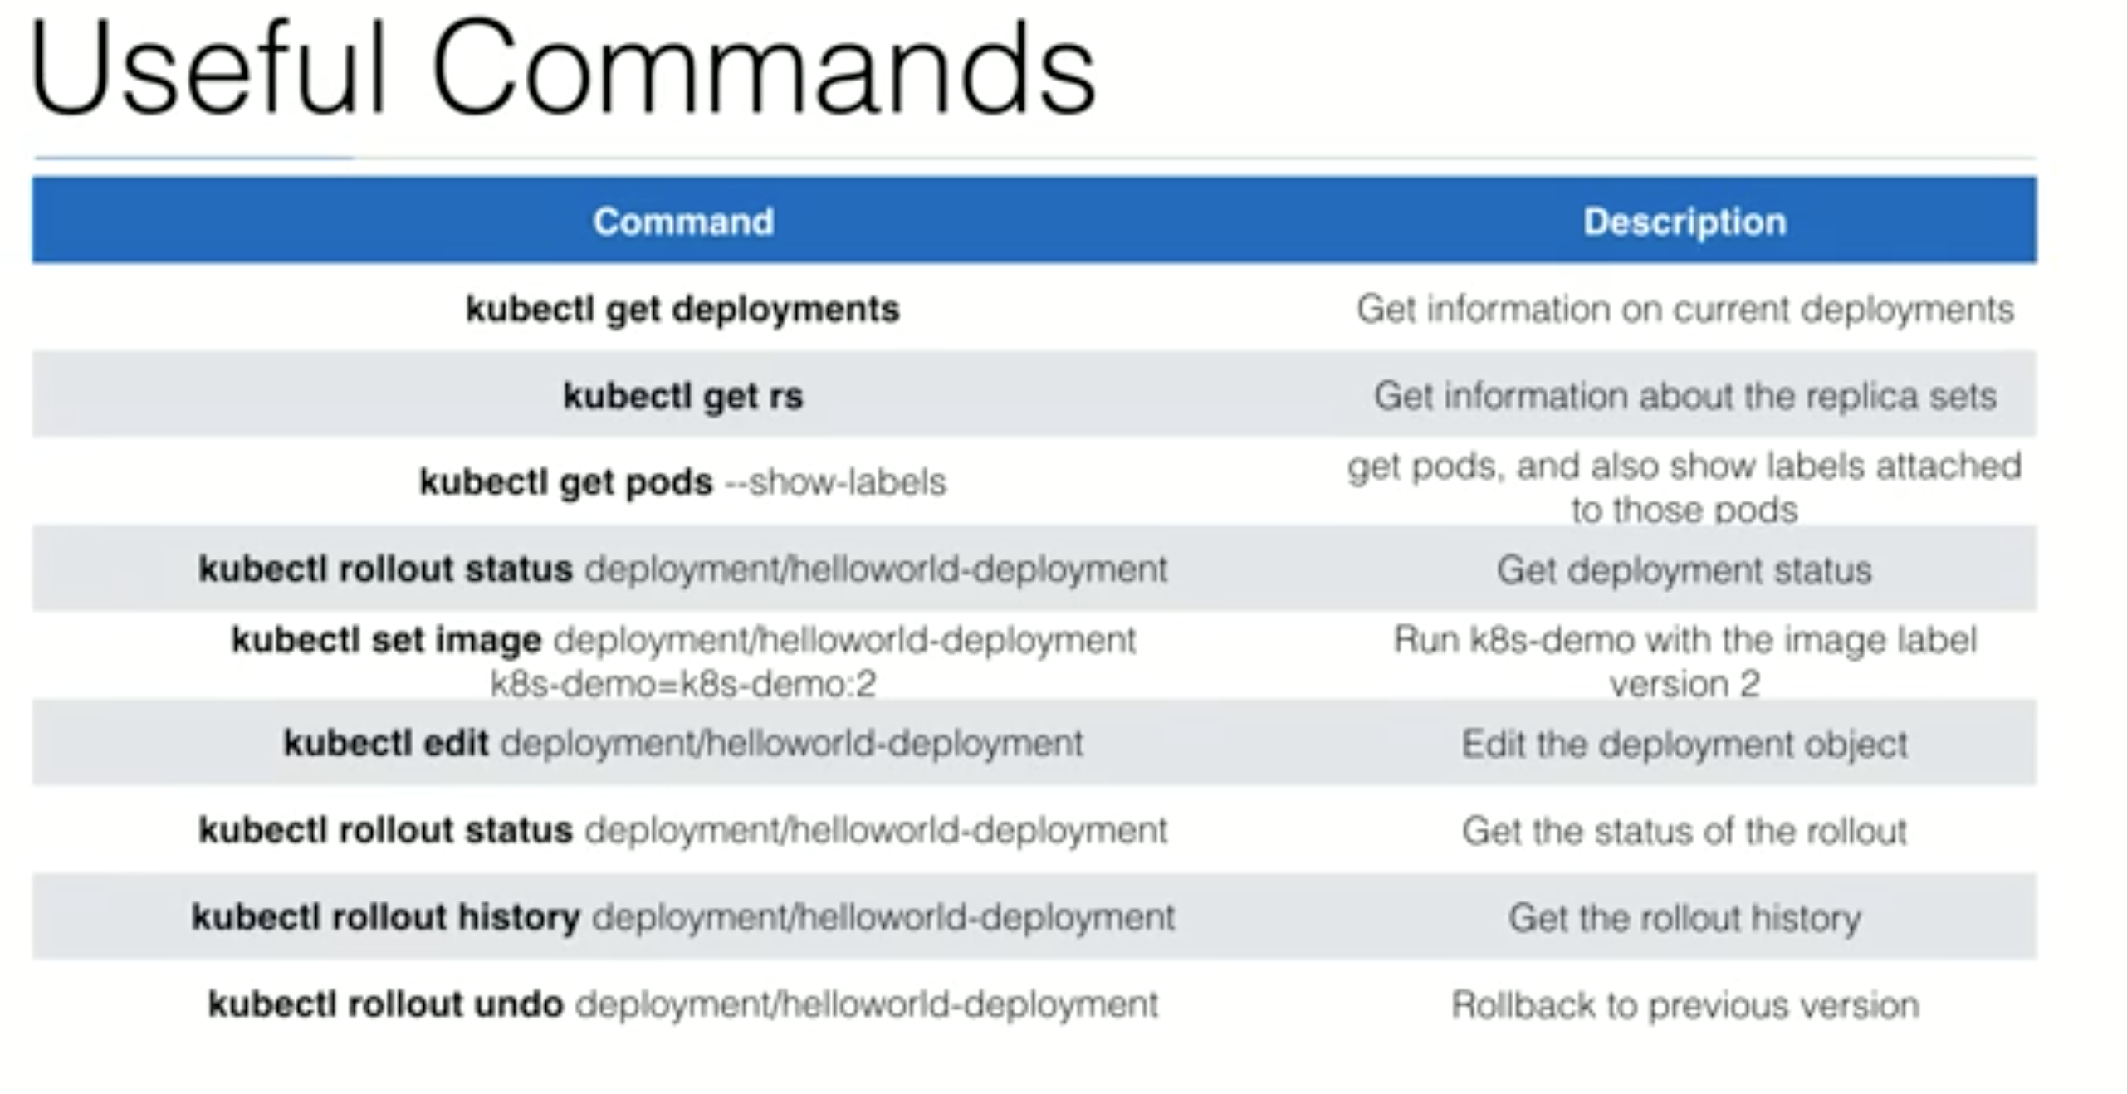
Commands-deployment

Slide 108
Sample Application on K8s
Lets run nginx application on Kubernetes.
kubectl run sample-nginx --image=nginx --replicas=2 --port=80
kubectl get pods
kubectl get deployment
kubectl expose deployment sample-nginx --port=80 --type=LoadBalancer
kubectl get services
kubectl get services –o wide

